Slide 1


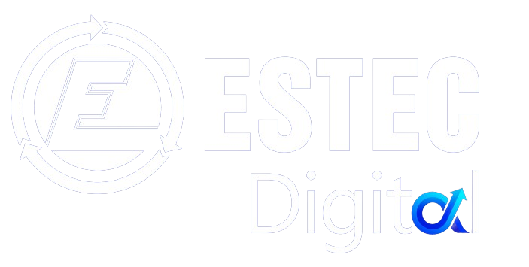


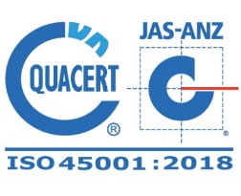
AUTOMATION & DIGITALIZATION
TONG Phuoc Thien
Managing Director ESTEC Digital

Slide 2

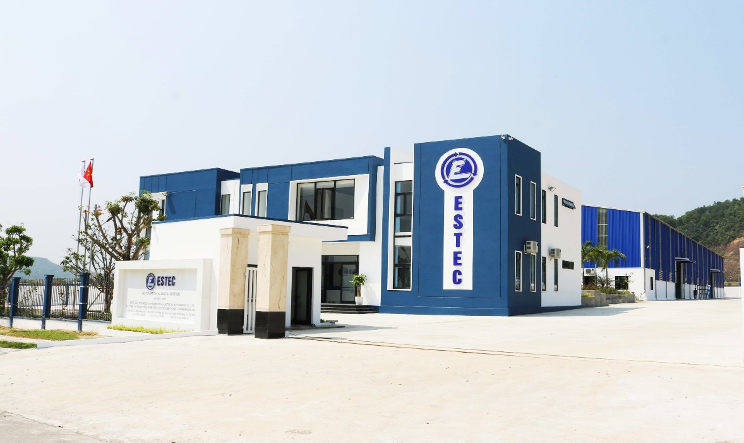
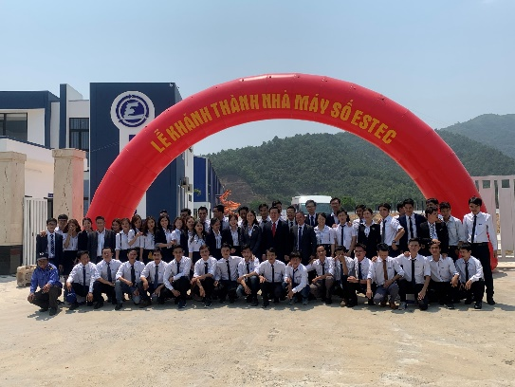
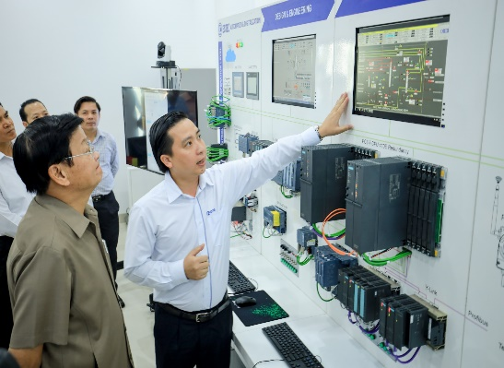
POWER OF ENGINEERING!
ESTEC - EAST SEA TECHNOLOGY ENGINEERING ELECTRICAL AUTOMATION CO., LTD
We are the top solution provider in automation, digitalization for industries in Vietnam. We provide a complete solution from design, engineering to software programming, system integration, equipment supplying, installation, testing, commissioning, training and technology handover.
ESTEC is proud to win trust of customers, thanks to its capability of project execution, technology know-how, quality assurance, innovative solutions and professional services.
Power of engineering and project successes are the foundation for our development!
Please visit us: estec.vn
We are certified by:

Slide 3



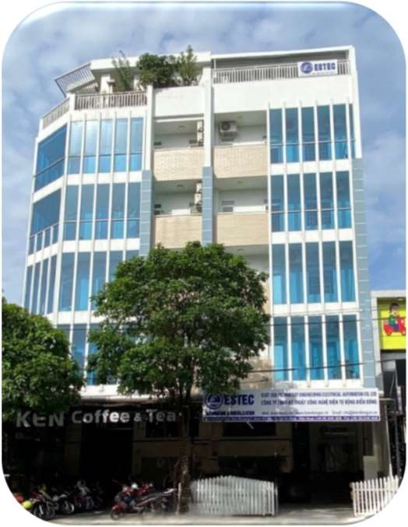



OFFICES & DIGITAL FACTORY
HCMC HEAD OFFICE
61 Le Duc Tho Str., Ward 7, Go Vap Distr., HCMC
DANANG DIGITAL FACTORY
Lot A14, Road 7, HiTech IP, Hoa Lien, Hoa Vang, Danang City
Ha Noi
Representation office
87 To Hieu Str., Cau Giay District, Ha Noi Capital
Da Nang
Digital Factory
140+ employees with more than 80% engineers
Ho Chi Minh
Head office

Slide 4
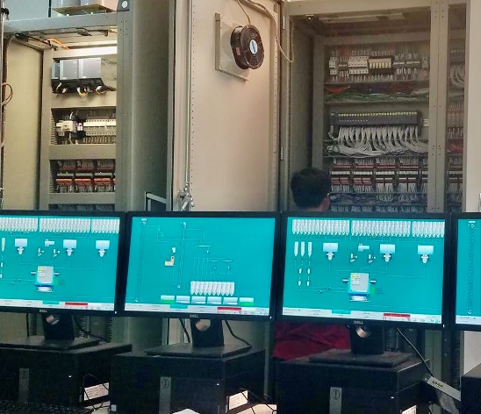
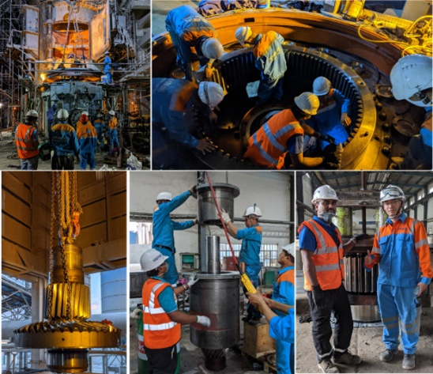
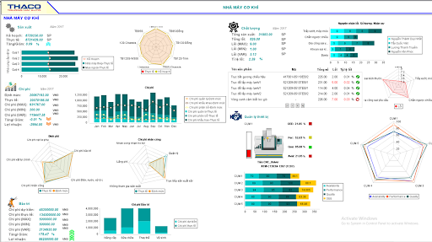
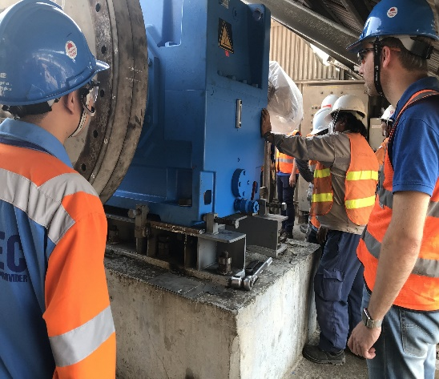
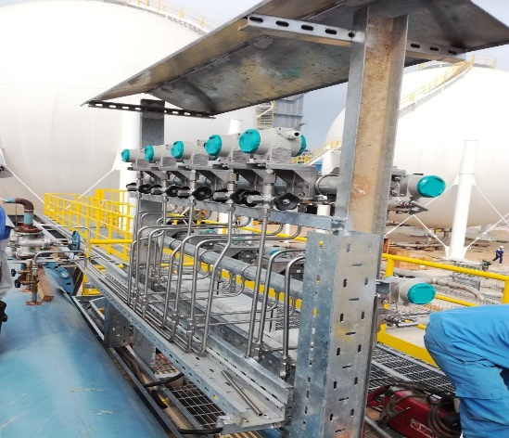

OUR EXPERTISES
Automation &Electrical
Solutions
Industry Services
Industry Products
Process Instrument Solutions
Digitalization solutions

Slide 5
AGENT GEN AI IN MANUFACTURING
We are an active actor in production manufacturing data analysis, the factory data sources come from all of domains like ERP, SCADA, DCS, CMMS, Power Management System, Quality Management system, …
We already provide to our customer traditional dashboard solutions that rely on prebuilt reports.
Agent Gen AI is a cutting-edge artificial intelligence solution designed specifically for the manufacturing sector Cement, Mining, Power plants, Pharmaceuticals, Oil&Gas.
Our Agent Gen AI enables users to retrieve real-time data insights using natural language queries, providing dynamic and consistent data analysis, driving efficiency and innovation.

Slide 6
PROBLEM STATEMENT AND AGENT GEN AI
BOD, Managers of factories, face challenges in extracting meaningful insights from their operational data.
Traditional dashboard solutions are: Rigid and Predefined – Limited to prebuilt reports that need to have many to get consistent information. do not adapt to changing needs.
No Flexibility to Use – Require specialized knowledge to navigate and interpret data.
Data Inconsistent – Different systems may produce conflicting reports, reducing trust in analytics.
Our Agent Gen AI provides a next-generation AI assistant, AI-powered solution enables manufacturing professionals to
Enables natural language queries to access real-time operational data instead of predefined dashboards.
Automates customized data insights based on user intent without the need for preconfigured dashboards.
Integrates and ensure data consistency by integrating various existing operational systems into a unified AI-driven analysis tool to ensure consistent and reliable data analytics.

Slide 7
TARGET MARKET
Our target industries include:
Cement Manufacturing: Optimizing production processes, production costs, and resource management.
Mining: Enhancing operational efficiency through real-time data insights.
Hydraulic Power Plant: Turbine optimization, water flow efficiency, improving asset performance and predictive maintenance.
Coal Power Plant: Boiler performance, emissions control, asset performance, predictive maintenance.
Pharmaceuticals: Batch traceability, regulatory compliance, lab integration
Oil&Gas: Monitoring critical assets, predicting failures, and optimizing throughput. Pump/turbine health, pipeline monitoring, leak detection

Slide 8
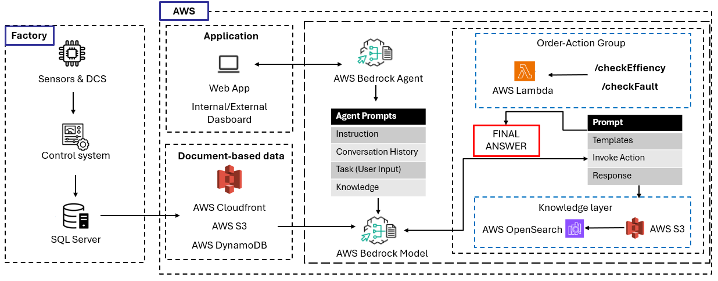
TECHNICAL STACK & AWS SERVICES
Agent Gen AI leverages AWS services for scalability, security, and AI-driven analytics:
AWS Bedrock: Foundation for generative AI models. AWS Lambda: Serverless execution for real-time data processing.
AWS CloudFront: Content delivery network (CDN) that accelerates the distribution of static and dynamic web content.
AWS OpenSearch: Open-source search and analytics engine.
AWS DynamoDB: Data Base Services
AWS S3: Scalable object storage service.
Techstacks
+ Database: Mongodb/AWS DynamoDB
+ Backend: NestJS/Python
+ Frontend: NextJS
+ AI Framework: AWS Bedrock Agent/Langchain (if needed)

Slide 9
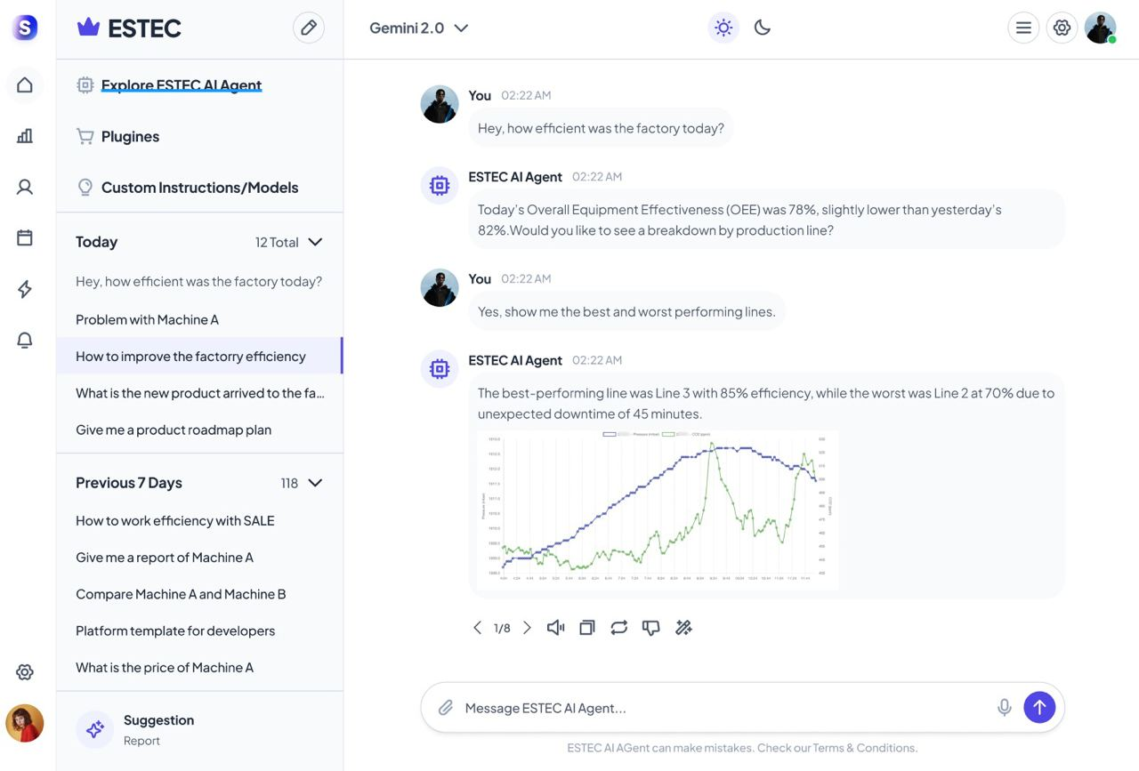
AWS ACTIVATE APPLICATION
We don’t finalize yet the user interface, in Vietnamese and English, with Natural Language Use Cases but some sample based on what we propose to our customer currently with predefined dashboard
Daily Production:
What was the production output for Line 1 today?
Compare cement production this week to last week.
….
Maintenance Plan:
Show me the maintenance schedule for the next 7 days.
Which equipment we have to stop this week due a maintenance plan.
….
Product Quality:
Display the latest quality inspection results today
Are there any deviations in product quality over the last 3 shifts?
…
Energy & Resource Use:
How much electricity did we consume in the last 24 hours?
What was the average water usage per ton of product yesterday?
…
Environmental Compliance:
Were there any emissions threshold violations today?
….

Slide 10
OUR BUSINESS MODEL & AWS
Our Business Model
SaaS Model – Subscription-based pricing for manufacturers.
Enterprise Licensing – Custom solutions for large-scale industrial clients.
Consulting & Integration Services
Deployment support and custom model training.
AWS
Agent Gen AI revolutionizes how manufacturers interact with data, providing real-time, driving efficiency and innovation.
With AWS, we can accelerate development, enhance scalability, and drive AWS adoption across industrial operations.
We are eager to collaborate with AWS and leverage its ecosystem to bring our vision to life.

Slide 11
EXPECTED OUTCOMES & MILESTONES
Phase 1 (0-3 months): Core Development & AWS Integration
Develop V1 of the AI Agent with AWS Bedrock for generative AI.
Set up the data pipeline using AWS S3, Lambda, and OpenSearch for real-time analytics.
Fine-tune AI models for manufacturing insights.
Deploy an initial backend using AWS Lambda + API Gateway for serverless execution.
Phase 2 (4 months): Working Demo & Beta Launch
Build a fully functional demo to showcase AI-driven insights.
Optimize model performance using AWS SageMaker (if needed for custom fine-tuning).
Start Beta testing with selected manufacturing partners.
Implement real-time dashboards using OpenSearch & CloudFront for reporting.
Phase 3 (5-6 months): Full-Scale Deployment & Optimization
Scale up the AI Agent for broader manufacturing use cases.
Optimize AWS costs and enhance security with IAM roles & VPC integration.
Deploy a commercial-ready version with AWS infrastructure optimized for performance.
Develop a customer onboarding framework for adoption at scale.

Slide 12
CONCLUSION
Agent Gen AI transforms how manufacturers interact with data, driving efficiency and innovation.
We seek AWS Activate funding to cover initial AI model training and cloud infrastructure costs.
With AWS Credits, we can accelerate our mission to deliver real-time, intelligent insights across industrial operations. We look forward to collaborating with AWS to scale this solution.
Our AI agent will drive increased AWS service adoption among manufacturing enterprises adopting GEN AI driven automation.

Slide 13
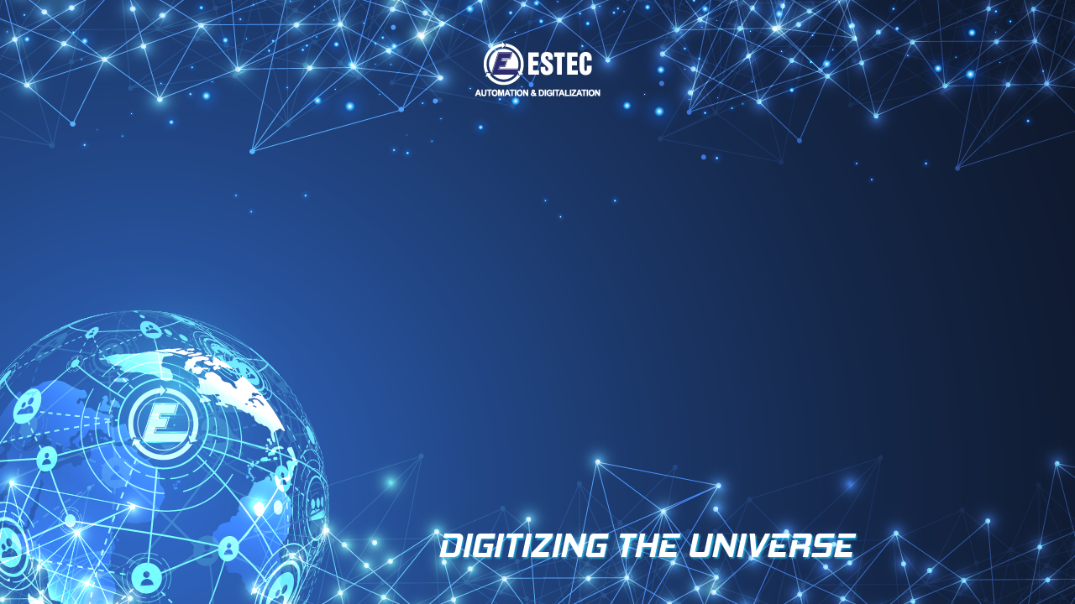

THANK YOU !
Contact us at:
Head office: 61 Le Duc Tho Street, Ward 7, Go Vap District, Ho Chi Minh City, Vietnam.
Factory: Block A14, Street 7, Da Nang Hi-tech Park, Da Nang City, Vietnam
Representation office: 87 To Hieu Str., Cau Giay District, Ha Noi Capital
T (+848) 5446 4649 F (+848) 5446 4648 Website: biendongco.vn; estec.vn

